Slide 1
Tabletop Exercise
October Monthly Exercise
Bus Crash

Slide 2
Welcome and Introductions
Opening remarks
Facilitator
What do we hope to gain from this exercise?

Slide 3
Exercise Agenda
Welcome and Introductions
Housekeeping
Exercise Overview
Goals
Objectives/Core Capabilities
Roles and Responsibilities
Structure
Rules for Players
Tabletop Process
Scenario-Driven Exercise
Facilitated Discussion in Four Modules
Hot Wash
Closing Comments
Debrief

Slide 4
Exercise Goals
Test plans to prepare for, respond to, and recover from a critical incident.
Ensure effective coordination of plans and actions with school personnel, emergency responders, and community partners.
Strengthen relationships with your response partners.
Identify areas for improvement and develop a corrective action plan.

Slide 5
Objectives and Core Capabilities
To demonstrate the district’s ability to establish an Incident Command framework that allows for an effective response to a critical incident.
Evaluate the effectiveness of Emergency Operations Plans that have been developed relating to the response to an incident involving a school bus.
Demonstrate the district’s ability to coordinate with local and regional law enforcement and other first-response agencies during the response to a critical incident
Evaluate the systems and practices of communicating with internal and external partners.

Slide 6
Participants Roles and Responsibilities
Players: Respond to the situation presented based on your knowledge of response procedures, current plans and procedures, and insights derived from training.
Facilitator(s): Responsible for moderating and keeping participant discussions focused on exercise objectives and core capabilities and ensuring relevant issues are explored; provide situational updates and additional information; resolve questions as required.

Slide 7
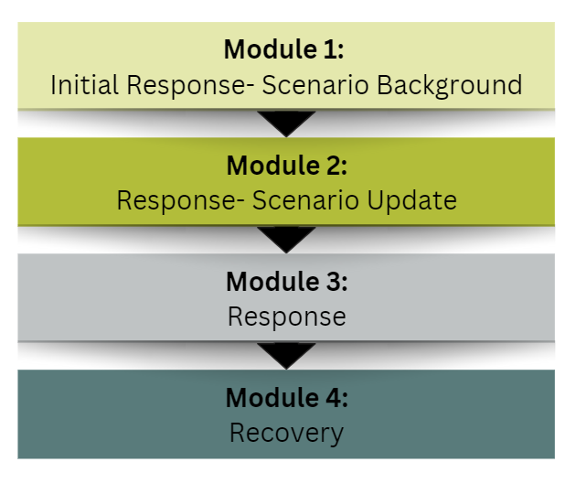
Exercise Structure
A scenario-driven, facilitated, discussion-based exercise
The exercise is divided into four modules, followed by a debrief.

Slide 8
Rules for Players
There are no right or wrong answers.
Varying viewpoints are expected and will be respected.
“Exercise decisions” are not precedent-setting.
Players are encouraged to consider different approaches and suggest improvements. “Think outside the box.”

Slide 9
Tabletop Processes
A scenario and update statements will be used to generate a discussion of probable response actions.
Participants will provide situational responses based on established procedures and plans. The Emergency Operations Plan (should be) available for reference. Other than maps and diagrams, no additional materials will be provided.
The exercise will conclude with the development of action steps needed to support future mitigation and preparedness efforts.

Slide 10
Module 1
Initial Response:
Scenario Background

Slide 11
Date: October 20th Time: 3:00 pm
The school day has ended, and bus drivers are on their routes getting students home. The weather is clear and sunny, and it is a beautiful autumn day in Vermont.
The driver of bus 225 rounds a corner in the roadway on her normal afternoon route when she sees a small car traveling in her lane coming toward the bus. The driver applies the brakes and veers toward the shoulder of the road but cannot avoid colliding with the oncoming car.
You are alerted of the crash and learn that EMS, fire, and police are all enroute to the scene.

Slide 12
Discussion
Based on this information, what immediate actions do you take? Explain your reasoning.
What immediate information do you need and how will you get it?
Based on your current EOP, what is your response protocol in a situation like this?
What notifications must be made? Who will be notified? How will they be notified? Who will make the notifications?
Will someone travel to the scene and if so, who will that be?
What will their responsibilities be once they arrive?

Slide 13
Take five minutes to think about the previous questions and the actions you will take.

Slide 14
Module 2
Response

Slide 15
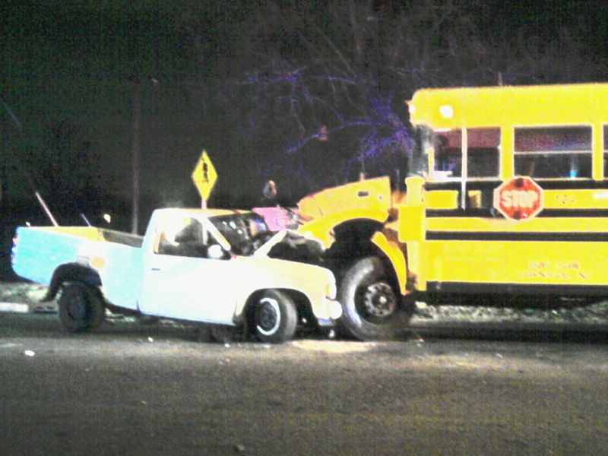
Date: October 20th Time: 3:30 pm
You learn that several students are injured, however, the extent of those injuries is unknown at this time. You have learned that the occupants of the car have sustained significant injuries and there is one fatality. The occupants of the car are students at the high school.
Occupants of the car and some of the students from the bus have been transported to the local area hospital. Students have begun to make cell phone calls and send text messages, as well as send out live feeds from the scene.

Slide 16
Discussion
With the information that you now have, what specific response actions will you take and why?
What are your immediate concerns regarding the students at the scene and those that have been transported to the hospital?
How and what will you communicate to parents?
How will you handle media inquiries that are beginning to come into the school?
How does your EOP address communication with the school community who are learning about this incident through social media?
Who is in charge, and where will that person be? (At the school? At the crash scene? At the hospital?)

Slide 17
Module 3
Response – Scenario Update

Slide 18
Date: October 20th Time: 4:30 pm
School officials report to the hospital. The names of the injured and deceased have not been officially released but due to social media a great deal of information has been generated to include the identity of the student who died. Some of the information that has been generated on social media and through other sources is inaccurate.
Several Vermont news stations and newspapers are requesting an interview with a school representative.

Slide 19
Discussion
How will you work with law enforcement as they investigate this crash?
How will you work with law enforcement relative to the media requests for an interview and further information?
How will you communicate accurate information to the parents/ families of the students who were on the bus?
How will you communicate to your school community?

Slide 20
Module 4
Recovery

Slide 21
Scenario Update
Several hours have passed, and you have learned that the preliminary investigation revealed that the car’s operator was traveling at a high rate of speed and had crossed the roadway’s center line directly in the path of the oncoming school bus.
In spite of the bus driver’s best efforts, there was no way to have avoided the crash.
All injuries to the students on the bus were minor and those that were transported to the hospital have been released.
The students in the car that survived the crash remain hospitalized with serious injuries.

Slide 22
Discussion
How will your crisis team deal with this event?
If you do not have a crisis team, what other resources do you have available? Are there local mental health agencies whose services you can use, and what is your school’s relationship with those agencies?
What steps will you take in the coming days and weeks to address the trauma experienced by students, faculty, and staff?
Do you consider a de-brief with all staff to ensure they are okay? If so, who does it, when will the debrief take place and how?
Have you considered the Vermont School Safety Center resources in planning for an event like this?

Slide 23
Hotwash
Name a few identified strengths in your response to this incident.
Did you identify anything that’s not covered in your EOP?
Were any equipment needs identified?
What do you know now that you didn’t know prior to this exercise?
What action steps should this group take now? Are there changes or improvements that you will make?
What are the major lessons learned from today’s discussion?
What are the tentative next steps to continue the discussion and address any areas of concern?

Slide 24
Where do we go from here?
Specific Issues Identified | Person assigned to follow-up | Timeline of completion 3, 6, 9 months…

Slide 25
Stay Connected With Us
We would like to know if this exercise was helpful and hear about your experience with this training. Please reach out to us with your feedback to help us improve future training.
Rob Evans, Vermont School Safety Liaison revans@cosecure.com.
Sunni Eriksen, School Safety Programs Manager Sunni.Eriksen@vermont.gov.
Dee Barbic, Director of Violence Prevention Dee.Barbic@vermont.gov.
Vermont School Safety Center https://schoolsafety.vermont.gov/
An affiliate of

