Slide 1
Active Shooter Response
Run-Hide-Fight
Faculty and Staff Training

Slide 2
Goals
1. Discuss importance of “options based” response to a violent intruder
2. Review past response methodologies and the need for change
3. Identify personal responsibilities and situational awareness
4. Review law enforcement actions upon their arrival
5. Impacts of this type of training on our school communities

Slide 3
Take Care of Yourself
  These are critical issues to discuss as school professionals
  It is understood that the topic could and will make some of us uncomfortable
  If you are having a strong response, please pay attention to it and take care of your emotional needs

Slide 4
The Evolving School Safety Landscape
PREPAREDNESS
PREVENTION MITIGATION
Cyber Threats
School Violence
School Security Program
Security Cameras
Access Control & Visitor Management
Alarm Monitoring
Education Awareness & Training
Lighting
Way-Finding
Policy & Standards
Emergency Communication
Safety Surveys
Resiliency
Continuous Improvement
Criminal Mischief
Severe Weather
RECOVERY
RESPONSE

Slide 5
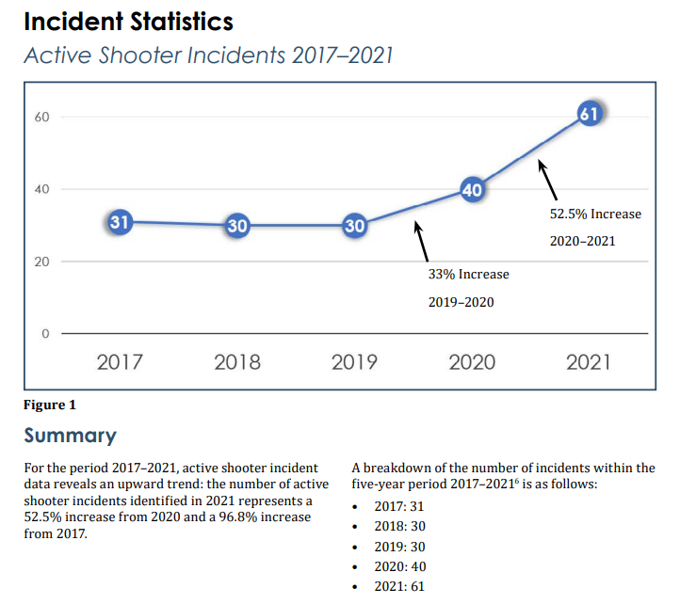

Slide 6
What is an Active Threat?
An Active Threat is defined as a violent situation in which a person(s) is, or appears ready to be, actively engaged in killing or attempting to kill others on school property. In most cases, this active threat involves an active threat using a firearm(s) and displaying no pattern or method for selection of victims. In some cases, active threats involve other weapons and /or improvised explosive devices intended to cause harm to victims or to impede police and emergency responders. These devices may detonate immediately, have a delayed detonation fuse, or may detonate on contact.

Slide 7
School Violence: What we know
  Active threat situations involving a shooter are highly fluid, as incidents evolve quickly and are unpredictable
  The active threat continues until stopped by law enforcement, suicide, or other intervention
  Often the active threat situation is over BEFORE law enforcement or first responders arrive on the scene
  THE MOMENTS BETWEEN WHEN AN ACTIVE THREAT BEGINS AND WHEN HELP ARRIVES ONSITE ARE CRITICAL AND OUR RESPONSE CAN SAVE LIVES

Slide 8
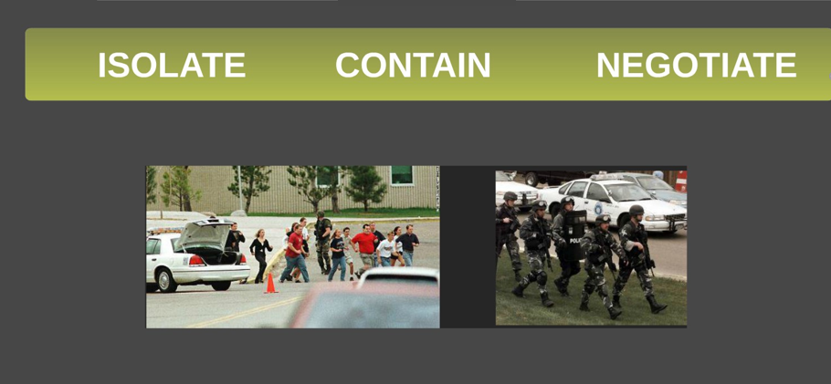
Traditional Law Enforcement Response to a Violent Intruder

Slide 9

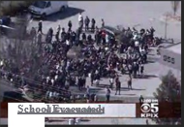
Where are we headed?
Options-Based Response to Violent Intruders
  No one-size response action fits every situation
  Individual life-saving options
  The importance of situational awareness

Slide 10

The importance of
SITUATIONAL AWARENESS
How will I know what to do in any emergency?

Slide 11
Why enhance the traditional Lockdown?
Past incidents taught us that we needed to have other options available
These situations are over in 3-8 minutes requiring immediate action
What may be happening in one part of the building, may not be happening in another
Same crisis MAY require different responses

Slide 12




Key Elements of Options-Based Response
  All adults in the building are empowered to use information at their disposal to make the most appropriate decision about their actions
  Provides each adult with options depending on the nature of the threat
  Distributes responsibility for personal safety and decision making
  Allows for faster notification to all staff of a potential active threat

Slide 13

Why do we do this?
Trained Mind
  Anxious
  Recall what they’ve learned
  Preparing to act as rehearsed
  Takes decisive action
  Untrained Mind
  Panic
  Disbelief & Denial
  Shock
  Freezes/Hesitates

Slide 14

Thank you for flying with …
Fire Drill
Turn off lights
Close windows
Close doors
Walk single file
Be silent
Meet at warehouse, etc.
Airline Flight
Fasten seatbelt
Oxygen mask
Life vest
Identify exits (One nearest may be behind you!)
Aisle path lighting

Slide 15
Run, Hide, Fight
Similar to Hide Out, Get Out, Take Out
Concept is to:
Run – if you can safely escape the area of the threat, you must make a decision based on the best information available
Hide – find a safe location to hide and avoid detection and potentially reinforce or “harden” your location
Fight – when faced with no other option, you may need to confront an active threat with the resolve that you will survive the encounter

Slide 16


What is RUN-HIDE-FIGHT?
RUN, HIDE, FIGHT is the US Department of Homeland Security’s recommended emergency response protocol.
Does NOT replace current safety protocols or regular drills already in place such as LOCKDOWN or EVACUATION.
DOES give additional tools that may be used to respond in an ACTIVE THREAT SITUATION.

Slide 17

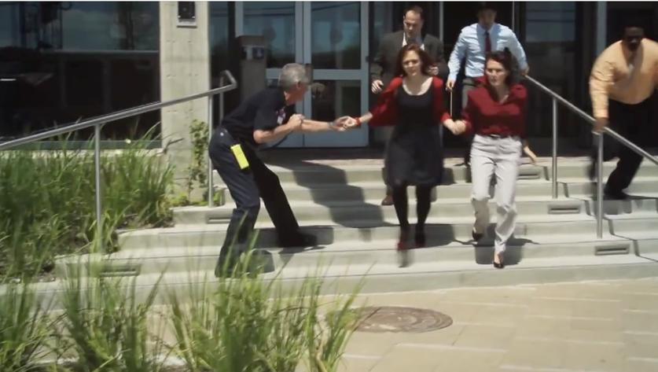
Run
  Can be faculty or student initiated
  Have an escape route and plan that includes identified assembly areas located a safe distance away from the incident (Accountability)
  Leave personal belongings behind
  Ensure those with mobility challenges or other disabilities are cared for
  Must be prepared to change evacuation/run routes based on situational awareness
  Be prepared to transition to a lockdown /hide or fight option based or situational awareness
  Keep your hands visible

Slide 18

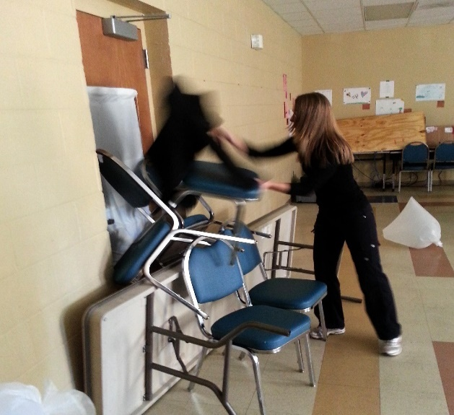
Hide and Reinforce
Takes steps to barricade, reinforce or fortify your location
  Hide in an area out of the perpetrator’s view
  Lock doors and use items such as desks, chairs, bookshelves to barricade the door
  Silence cell phones
  Ensure these areas are identified through training

Slide 19

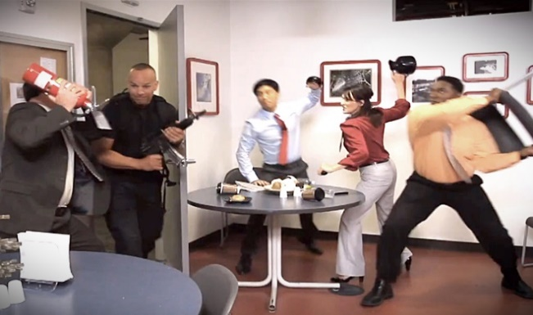
Fight
  Last option for survival
  Taking back control of the situation
  Must assess individual capabilities
  Enhance survivability by utilizing available resources (fire extinguisher, books, heavy objects) to defend or protect yourself and incapacitate the perpetrator
  Consider developing a plan with others in your location to determine the best options for your survival (Swarming, distraction)

Slide 20
Turn and Talk
What are the most important factors that come into play in making the decision to Run, Hide or Fight?
What should you do if you don’t know where the threat is?
What can I do to ensure I am taking care of myself and others during this type of response?

Slide 21
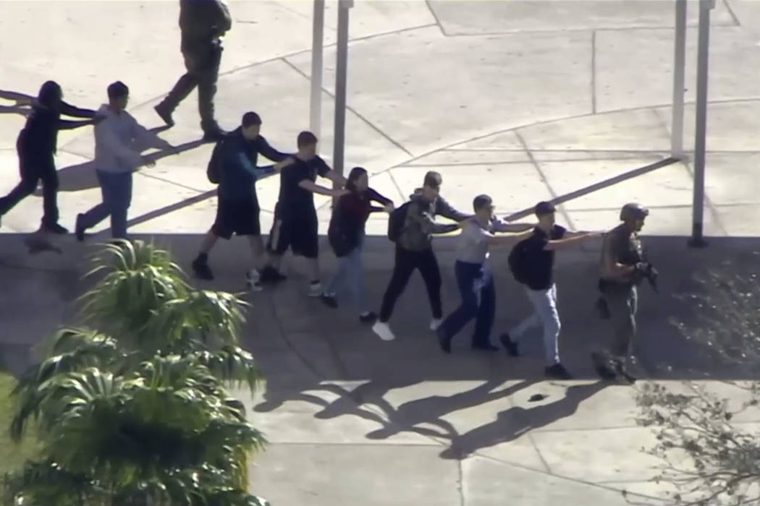
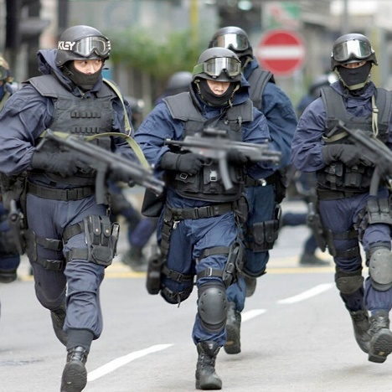
Police Response to an Incident
  The police mission is to stop the suspect as soon as possible.
  They will proceed directly to the area where the last shots were heard
      The first officer on the scene will respond to the threat
      Officers may wear regular patrol uniforms or external bulletproof vests, Kevlar helmets and other tactical equipment
      Officers may shout commands, and may push individuals to the ground for their safety

Slide 22
Next Steps
  Review the ACTIVE THREAT PROCEDURE FOR YOUR SCHOOL
  Re-examine your teaching spaces and evacuation routes thinking about three possible responses:
    RUN
    HIDE
    FIGHT
  Ensure processes are in place to notify the entire school community of this type of threat. Staff responsible for making these notifications should practice using the schools emergency notification systems.

Slide 23
Post Tragedy Response
Provide strategies for your school to enhance readiness, response, and recovery to help the school community in the event of a tragedy
  Be prepared before a crisis happens
  The immediate response influences long-term recovery
  Provide adequate, appropriate and sustainable mental health supports your school and community resources
  Be prepared to address a variety of reactions over the long-term
  Seek to find a “new normal” – things may not be the same following an event.

Slide 24
Turn and Talk
Discuss any challenges you have with what you have learned.
Discuss if you feel more empowered to make individual life saving decisions? If not, why not?
Can you identify any future training needs to ensure your school is better prepared to respond to a violent intruder.

Slide 25
Takeaways
What are your best exit options for your classroom or teaching space? (Remember to think about more than just one exit route in case your main pathway to exit is blocked or unsafe to use.)
How would you reinforce your classroom, teaching space or office if you were in a situation that would lead you to opt for the Hide action?
Think about what items in your classroom or teaching space are readily available if you are in a situation that leads you to the Fight option.
Review the (15 minute) Run Hide Fight training video contained in the “Resources” section of the presentation.

Slide 26

Where is the safest place to be during an emergency?

Slide 27

Resources and Connections
    Vermont Agency of Education and DPS Twitter Feed https://twitter.com/vted_safeschool
Vermont School Safety Web Site: https://schoolsafety.vermont.gov/
Rob Evans: Director of K12 Services and Vermont School Safety Liaison revans@margolishealy.com
Sunni Eriksen, Vermont Emergency Management sunni.Eriksen@Vermont.gov

