Slide 1
Emergency Planning & Foodservice: How School Meals Programs Can Help
Salad Bar at Essex Town Schools
Essex, VT
In partnership with

Slide 2
Introduction
Objectives
Robert L. Evans
Manager of Organizational Assessment & K-12 Services
Margolis Healy

Slide 3
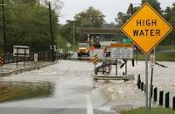
Types of Emergencies/Disasters That School Meals Programs Can Assist With
Individual Students Displaced
House fire
Localized flooding
Other emergencies that displace individual students or groups of students from their homes while school remains open
Unexpected School Closure
School Building Flooded
Power Outage at School
Civil Disturbance (strikes)
Snow Days
Community Affected
Large scale flooding, hurricanes, ice storms, power outages, tornados
Lots of community members displaced & need shelter and food
School may be open or closed

Slide 4
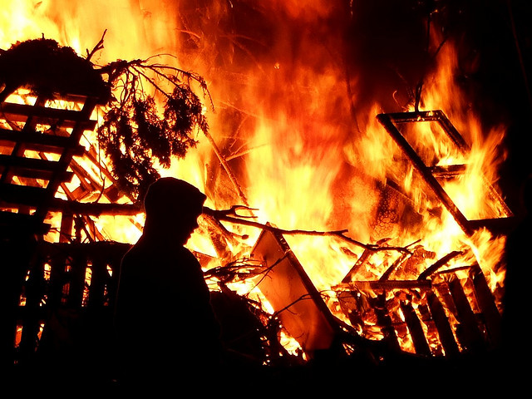
Feeding Individual Displaced Students

Slide 5
When Individual Students are Affected By Disasters or Emergencies
If a disaster such as fire or flooding affects individual students at your school, but school remains open, the affected student(s) may qualify for free meals.
Students who are displaced from their homes during a disaster of any size qualify as “homeless.”
Get information from school homeless liaison
Family can fill out new application
School Food Service Program Staff can fill out new application on behalf of families that they know are affected
In a Presidentially Declared disaster, affected families may receive “D-SNAP” benefits.
Family supplied case number
Direct Certification List
These students will be eligible for free school meals for the rest of the school year, plus the first 30 days of the following school year – even after they return home.
Notes:
Remember, even if a family has a place to stay - such as with a neighbor or relative – they would still count as homeless for the purpose of providing free meals through the school meals program.
No matter how wide spread the disaster is, if school is still open, you can and should continue to feed students through your usual school meals programs.

Slide 6
More on Identifying Homeless Students
The McKinney-Vento Homeless Assistance Act defines students experiencing homeless as children and youth who lack a fixed, regular, and adequate nighttime residence, including those who are:
Sharing the housing of others due to loss of housing, economic hardship, or similar reason
Living in motels, hotels, trailer parks, camping grounds due to lack of adequate alternative accommodations
Living in emergency or transitional shelters
Living in a public or private place not designed for humans to live
Living in cars, parks, abandoned buildings, substandard housing, bus or train stations, or similar settings
Migratory children living in above circumstances
Homeless students identified by the school homeless liaison or a shelter official are Directly Certified for free meals.
List of Vermont Homeless Liaisons: http://education.vermont.gov/sites/aoe/files/documents/edu-federal-programs-homeless-liaisons.pdf
Notes:
We have handouts of Vermont homeless liaisons.
If a family self-identifies as homeless (on an application), then they are categorically eligible.
Family can choose to decline assistance – that’s ok.

Slide 7
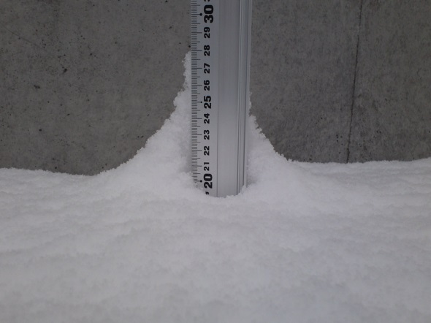
Feeding Students During an Unexpected School Closure
Notes:
When School is closed, we can’t continue to operate the school meals programs – but we still have some other options for feeding students and their families. For any short term or long term unplanned closure where school food service program staff and students can still get to the school building, or can get to an alternate site, you can consider operating the Summer Food Service Program or the Seamless Summer Option. This could be for a one-day snow day, where roads clear up enough by lunch time to prepare and provide a meal, or for a days long teacher or transportation strike.

Slide 8
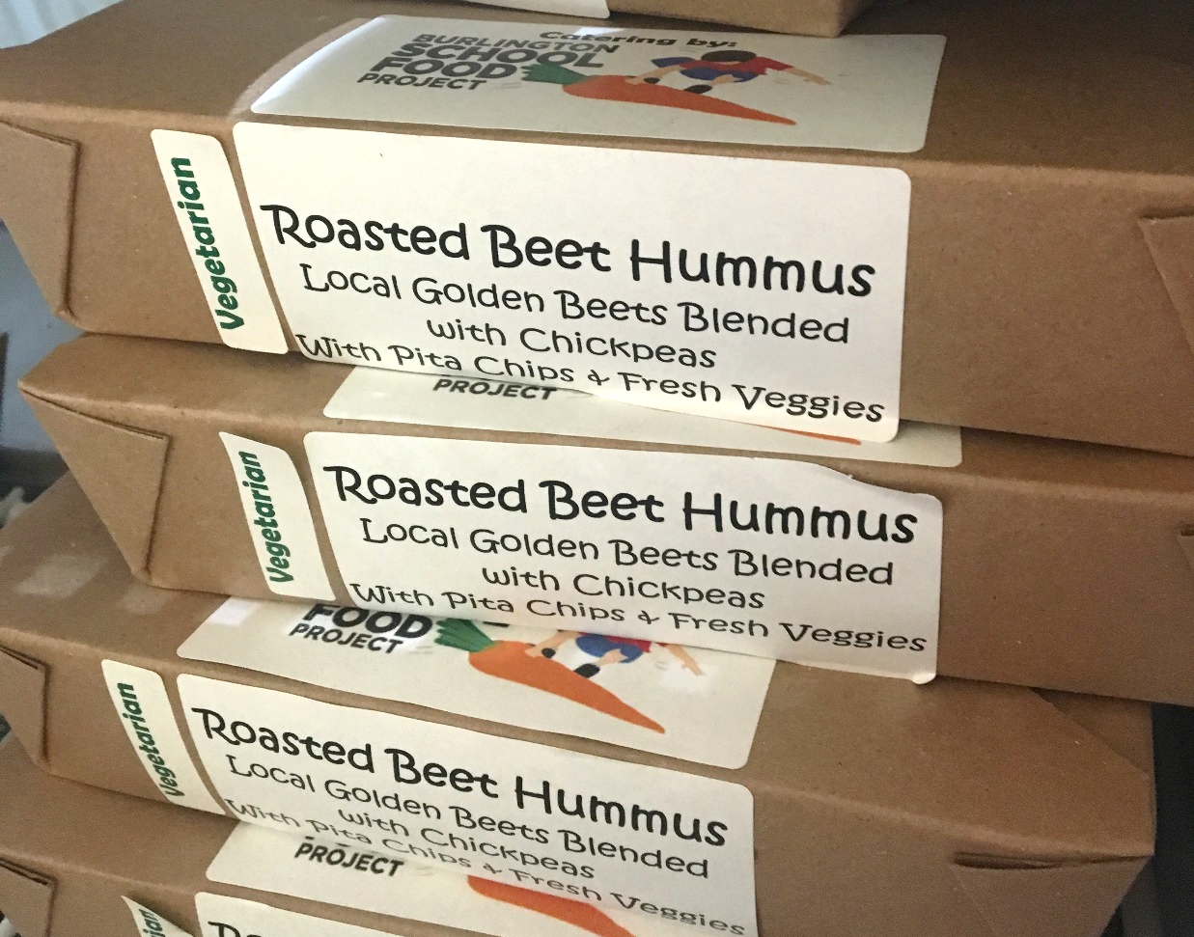
Using “Summer” Meals Programs During Unexpected School Closures
To get federal reimbursement for school meals, they must be served as part of an instructional school day. If school is closed, the School Breakfast and School Lunch programs cannot operate that day.
During unexpected school closures, we can still feed students by operating a “summer” meals program.
School Building Flooded
Power Outage at School
Civil Disturbance (strikes)
Snow Days
This option cannot be used during
scheduled school vacations.
Meals may be served at the school, or at
other locations.
Library
Community Center
Housing Development
Summer Food Service Program lunch boxes ready for distribution at Burlington High School

Slide 9
How to Turn On Summer Meals for Emergencies
Schools with existing Summer meals programs can edit their agreement with the state to add the necessary dates.
Schools that do not operate summer meals programs during the summer may still still be able to qualify and set up a program for use in an emergency. Ways of qualifying include:
The local school or meal site is located within a low-income census tract
The meal site is located at designated low-income housing
The school has more than 50% of their students qualifying for free and reduced meals
Meals served to F&R students can be reimbursed based on the individual students status
Contact Child Nutrition Programs as soon as you think you may have an emergency closing and want to go into summer feeding.
Contact Jamie Curley at Jamie.Curley@Vermont.gov or (802) 479-1207
Jamie will help you determine eligibility and assist with the agreement/application process

Slide 10
Summer Meals Regulations
Summer Meals Program regulations still apply when used for emergency feeding:
Sponsor must be nonprofit
Only one reimbursement rate
Health and safety rules must be followed
Meals must be eaten on site
Meals to children ages 0-18 are reimbursable
Meal pattern still applies
More flexible than school year
Record keeping requirements
http://education.vermont.gov/student-support/nutrition/summer-food-service
You can transfer food and supplies from your school meals program to the summer feeding program
Document the value of items transferred
Veggie Cups at Malletts Bay School, Colchester

Slide 11
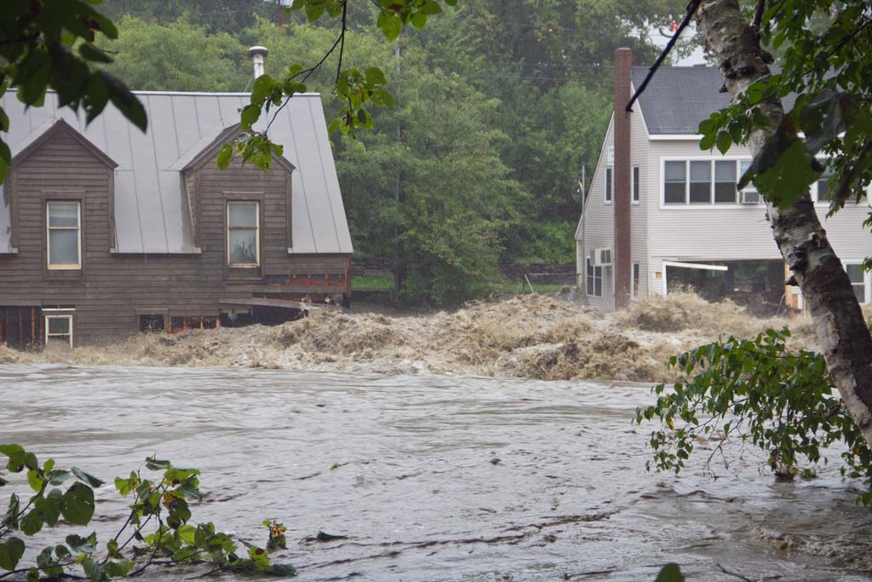
Feeding The Community During a Disaster
Flood waters from Tropical Storm Irene on the Ottauquechee River in Quechee, Vermont. Photo, Stephen Flanders
Notes:
When larger scale disasters hit our communities, school is likely to be closed and whole families are likely to be displaced and in need of food. In these situations, there are several tools to help pay for the cost of adult and volunteer meals. These include the use of USDA Foods, and FEMA reimbursement for meals and costs associated with meals. In addition, you can receive reimbursement for meals served to children ages 0-18 by operating the summer meals program, as we just discussed.

Slide 12
Using USDA Foods in Presidentially Declared Disasters or Situations of Distress
If you have permission from the State Agency (Child Nutrition Programs), you may use your USDA Foods to provide congregate feeding for children and adults.
Notify VT Child Nutrition Programs (Rosie Krueger) as soon as you practically can with the following information:
Projected timeframe for feeding
Number of persons to be served
Number & location of feeding sites
Quantity and Type of USDA Foods on hand that will be used
Additional USDA Foods that are requested
Keep records of the type, quantity and value of USDA Foods used and number of people served.
Rosie Krueger (Mary.Krueger@Vermont.gov, 802-479-1246)

Slide 13
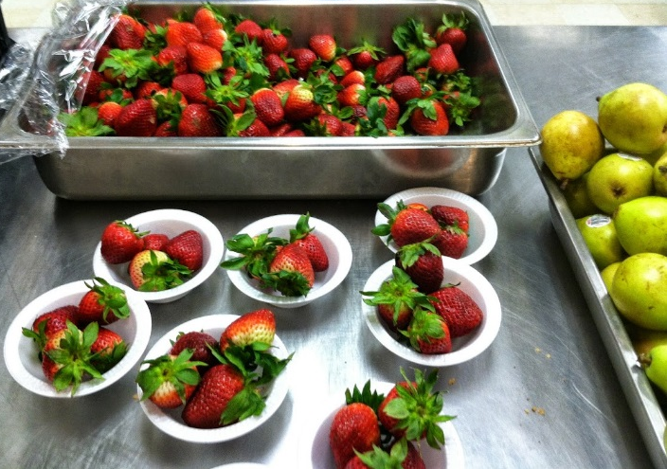
Using USDA Food, Continued…
In a Presidentially Declared Disaster, USDA guarantees replacement of USDA Foods served.
In a “Situation of Distress” (without Presidential disaster declaration) , USDA will provide replacement of USDA Foods if funding allows.
Note: In a situation of distress, USDA Foods are only allowed to be used for up to 30 days of congregate feeding. This limit does not apply to a Presidentially Declared Disaster.
All types of USDA Foods are included
“Brown Box” and DoD Fresh Produce
Volunteers & emergency workers may
be served meals containing USDA Foods
as long as they do not make up the
majority of people being served.
DoD Fresh strawberries served at Rivendell
Academy

Slide 14
FEMA Reimbursement
In a Presidentially Declared Disaster, FEMA should pay for:
75% of staff overtime directly related to the disaster
Document hours worked by SFA personnel during the disaster and wages paid.
75% of commercially purchased foods (non-USDA Foods)
Document value of all foods used for emergency feeding during the disaster
75% of non-food supplies
Document value of all supplies used for emergency feeding during the disaster.
Submit this information to the local Office of Emergency Management so that they can apply for reimbursement on your behalf.
Reimbursement for the other 25% may be available from the state or local government.
Notes:
You should also document any volunteer hours worked – FEMA will count those towards the 25 % local contribution.

Slide 15
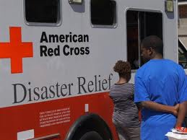
When Disaster Feeding Organizations Are Involved
Often, Emergency Feeding Organizations (EFOs) will quickly take over feeding responsibilities – but the School Food Service Program may still be involved.
EFOs may ask the State Agency (Vermont Child Nutrition Programs) to provide USDA Foods to their sites.
When this request is received, the State Agency will direct the EFO to use locally available USDA Foods first – maybe USDA Foods from your kitchen!
If the State Agency directs you to release USDA Foods to an EFO, document the type and quantity of USDA Foods released, and provide that information to the State Agency so that the foods can be replaced.
EFOs may want to use your school to prepare and/or serve meals for displaced persons.
Work with the EFO to come up with a formal arrangement for who will be in charge of the kitchen and how food, supplies, and any SFA staff time will be covered.
EFOs may buy meals from your SFA
Charge the EFO a per meal rate, and
subtract the value of USDA Foods used.
Notes:
So What starts the process?
In wide spread disaster, FEMA will be the first responders and provide Ready to eat meals and other basic needs to survivors until congregate feeding sites or mobile kitchens can be stood up.
Once arrangements are made for congregate feeding operations, a disaster feeding organization, like the Salvation Army, or the Red Cross, will request USDA Foods assistance from their State Distributing Agency or Indian Tribal Organization.

Slide 16
Preparation: What to do now
Create & Keep List of Disaster Contacts at home and school
Print out hard copies - remember, your computer might not work in a disaster!
Think about what type of disasters and emergencies are most likely in your community and how you would handle them
Involve your SFA staff and/or your school
Administration if you have a food service
management company, involve them in
your planning and make sure that your
contract covers what services the FSMC
will be expected to provide and how
they will be paid.
Write up your thoughts into a simple plan
Reach out to local Emergency
Management Office to become involved
in local disaster planning

Slide 17
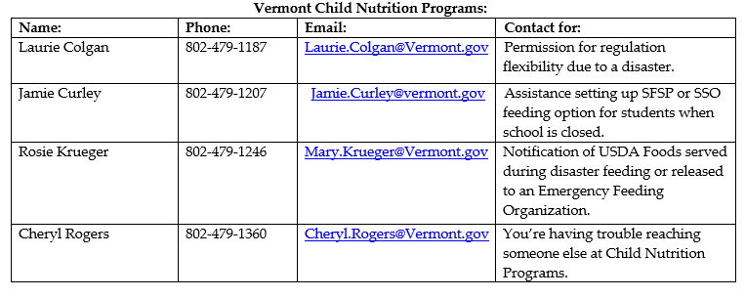
For questions and technical assistance, contact the Vermont Agency of Education, Child Nutrition Programs:

