Slide 1
ty training
Vermont Department of Public Safety &
Agency of Education

Slide 2
Targets & Expected Outcomes
Understand the revised crisis response commands for my school.
Explain why an “options-based” approach to an active threat is beneficial.
Understand what Run / Hide / Fight means in the context of an active threat situation in my school.
Understand my school’s and the District’s plan for implementing these changes.

Slide 3
Take Care of Yourself
It is understood that the topic could and will make some uncomfortable.
These are critical issues to discuss as school professionals.
If you are having a strong response - please pay attention to it and take care of your needs.

Slide 4
Why is there a need for this training?

Slide 5
Sadly, the violence in our world has touched our schools and communities in profound ways. We know active threats can happen anywhere at any time, places where we live, learn, work, eat, shop, recreate, and worship.
Active Threat Response Training is designed to promote safety as together we develop situational awareness and life skills that will keep our students, staff, and community members safe wherever they go.

Slide 6
Strengthening Our Response
Our best response to managing the threat of violence in schools is:
Prevention - we ensure our learning communities are safe and healthy environments where everyone is valued and belongs.
Preparedness - we learn and practice what to do if an active threat arises and we know what to do when the worst happens.

Slide 7
Crisis Response to Fire Threats in Schools
Regular fire drills were first instituted in 1958 following a tragic school fire at Our Lady of the Angels in Chicago. In the years since that time, fire-related fatalities have become extremely rare in schools.
Countless students since then were given knowledge and awareness of what to do to stay safe in a fire. Fire safety response and fire drills are now common in our schools and our culture.
We seek to build similar life skills for students and staff to face new threats of violence in our world.

Slide 8
School Violence: What We Know
Active Threat situations involving a shooter are highly fluid as incidents evolve quickly and are unpredictable.
The Active Threat continues until stopped by law enforcement, suicide, or other intervention.
Often the Active Threat situation is over before law enforcement, or first responders arrive on the scene.
The moments between when an Active Threat begins and when help arrives onsite are critical and our response can save lives.

Slide 9
What is an Active Threat?
An Active Threat is defined as a violent situation in which a person(s) is, or appears ready to be, actively engaged in harming, killing or attempting to harm or kill others on school property. In most cases, this active threat involves an active threat using a firearm(s) and displaying no pattern or method for selection of victims.
In some cases, active threats involve other weapons and/or improvised explosive devices intended to cause harm to victims or to impede police and emergency responders. These devices may detonate immediately, have a delayed detonation fuse, or may detonate on contact.

Slide 10
What is Lockdown?
Lockdown is defined as a classroom-based protocol that requires locking the classroom door, turning off the lights and placing students out of sight of any corridor or exterior windows.
During a Lockdown, the students are to remain quiet.

Slide 11
Recommended Change to Procedures
While LOCKDOWN is a component and likely the first measure, it is not an exclusive response to unfolding active threat situations where you are in danger.
Federal support has been given to the Run-Hide-Fight program, so we are making a change in how we think, potential responses, and how we will practice emergency drills with students.

Slide 12
Social-Emotional Learning Support
Creating learning environments where all learners feel safe and supported and develop empathy for others is also critical.
See Something, Say Something is a valuable piece of our emergency preparedness efforts. It provides a digital platform for anonymously sharing information BEFORE an incident occurs.
School Resource Officers develop relationships with students and staff as they engage in prevention activities. They are available inside the school to respond immediately to an Active Threat.

Slide 13
Prevention Efforts
Many incidents can be prevented using available resources:
Anonymous Tip Line:
802-857-7977
Blackboard App

Slide 14
Options-Based Response
In an Active Threat Situation, you can choose to:

Slide 15
What is Run, Hide, Fight?
Run, Hide, Fight is the US Department of Homeland Security’s recommended emergency response protocol
DOES NOT replace current safety protocols or regular drills already in place such as LOCKDOWN or EVACUATION.
DOES give additional tools that may be used to respond in an Active Threat situation.

Slide 16
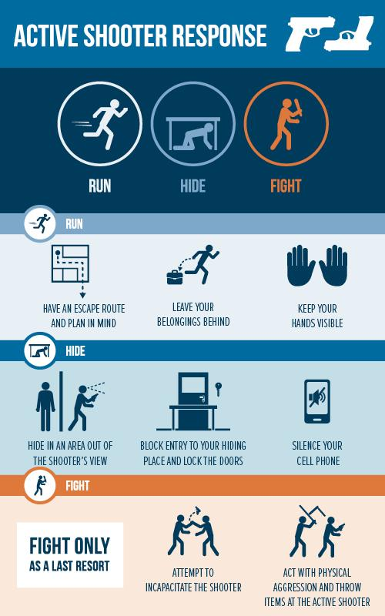
Run
Hide
Fight

Slide 18
Approaches to Drills
Incremental approach to practicing for an active threat situation.
High intensity drills that could cause undo anxiety to students, staff and parents will not be utilized.
The safety and security of our school community is a top priority for all of us.
Your support and engagement is critical to a successful and empowering implementation of our Crisis Response Protocols.

Slide 20
For Additional Support, please contact:
Robert L. Evans
School Safety Liaison Officer – Agency of Education
revans@margolishealy.com
Mobile: 802-839-0448
Office: 802-861-1357
Sunni Eriksen
School Safety Grant & Program Manager- Vermont Emergency Management
sunni.eriksen@vermont.gov
Mobile: 802-760-7117

