Slide 1
Tabletop Exercise
September Monthly Exercise
Threatening Student

Slide 2
Welcome and Introductions
Opening remarks
Facilitator
What do we hope to gain from this exercise?

Slide 3
Exercise Agenda
Welcome and Introductions
Housekeeping
Exercise Overview
Goals
Objectives/Core Capabilities
Roles and Responsibilities
Structure
Rules for Players
Tabletop Process
Scenario-Driven Exercise
Facilitated Discussion in Four Modules
Hot Wash
Closing Comments
Debrief

Slide 4
Exercise Goals
Test plans to prepare for, respond to, and recover from a critical incident.
Ensure effective coordination of plans and actions with school personnel, emergency responders, and community partners.
Strengthen relationships with your response partners.
Identify areas for improvement and develop a corrective action plan.

Slide 5
Objectives and Core Capabilities
To demonstrate the district’s ability to establish an Incident Command framework that allows for an effective response to a critical incident.
Evaluate the effectiveness of Emergency Operations Plans that have been developed.
Demonstrate the district’s ability to coordinate with local and regional local law enforcement and other first-response agencies during the response to a critical incident
Evaluate the systems and practices of communicating with internal and external partners.

Slide 6
Participants Roles and Responsibilities
Players: Respond to the situation presented based on your knowledge of response procedures, current plans and procedures, and insights derived from training.
Facilitator(s): Responsible for moderating and keeping participant discussions focused on exercise objectives and core capabilities and ensuring relevant issues are explored; provide situational updates and additional information; resolve questions as required.

Slide 7
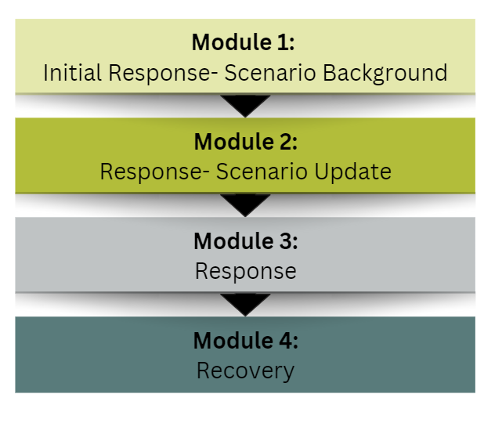
Exercise Structure
A scenario-driven, facilitated, discussion-based exercise
The exercise is divided into four modules, followed by a debrief.

Slide 8
Rules for Players
There are no right or wrong answers.
Varying viewpoints are expected and will be respected.
“Exercise decisions” are not precedent-setting.
Players are encouraged to consider different approaches and suggest improvements. “Think outside the box.”

Slide 9
Tabletop Processes
A scenario and update statements will be used to generate a discussion of probable response actions.
Participants will provide situational responses based on established procedures and plans. The Emergency Operations Plan (should be) available for reference. Other than maps and diagrams, no additional materials will be provided.
The exercise will conclude with the development of action steps needed to support future mitigation and preparedness efforts.

Slide 10
Module 1
Initial Response:
Scenario Background

Slide 11
Date: September 26th Time: 8:15 am
It is the start of the school year, and students are entering the school to begin their day. As the morning bell rings, a student enters a first-floor classroom, Mr. Smith’s English class.
The student closes the door after he enters and produces a handgun and begins waving it around the room and pointing it at students. A round is fired from the weapon narrowly missing several students.

Slide 12
Additional Information
The student fluctuates between yelling and crying. He is clearly highly agitated. Students in the classroom have hidden under desks or taken refuge on the floor.
Mr. Smith recognizes the student and is aware that there has been turmoil in his home life. The student had been involved in sports, playing soccer and participating in track. However, he has stopped his involvement in these activities and has seemed withdrawn. Furthermore, he has been identified as making suicidal references on social media.
After hearing the gunshot, students scrambled into classrooms, ran outside, or sought other locations in the school for safety. Someone has called 911.

Slide 13
Discussion
Based on this information, what immediate response actions will your school take?
Who makes this decision and why?
What exactly will you communicate to faculty, staff, and students?
How will you communicate this information?
What guidance will you give faculty, staff, and students during this ongoing situation?
What immediate concerns do you have, and how will you address them?
Do you inform the Superintendent’s office of this situation? If so, what actions would they take, if any?
Who will serve as the designated Incident Commander?
Who will take the lead on communications with law enforcement, emergency first responders, parents, and the media?

Slide 14
Take five minutes to think about the previous questions and the actions you will take.

Slide 15
Module 2
Response

Slide 16
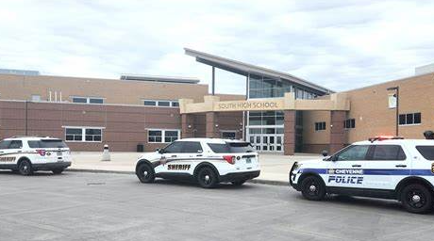
Date: September 26th Time: 8:30 am
Three officers responded to the school and made entry into the building. They are clearing the school, advising anyone they see to exit the building. They proceed directly to Mr. Smith’s classroom and attempt to establish communication with the student.
Other officers have arrived, and a perimeter has been established. EMS and the fire department have also responded to the school and tactical units are enroute as well.

Slide 17
Discussion
With the information provided, do your response actions change? If so, in what way?
Where are students, faculty, and staff going when they exit the school? Are they aware of where the designated relocation sites are?
How are students, faculty and staff being accounted for?
Do we consider opening up an incident command post? If so, who is in it, and what roles/responsibilities do they have?
Who is communicating with police and first responders? How is that communication taking place?
Is there a concern about parents coming to the school to pick up their kids? If so, how do we plan/prepare for that?

Slide 18
Module 3
Response – Scenario Update

Slide 19
Date: September 26th Time: 8:50 am
Additional officers continue to respond to the school. An officer outside the classroom has established communication with the student and is negotiating with him.
As media reports come out and social media platforms are buzzing about this incident, a large number of parents begin arriving at the school.
The media has also arrived at the school and is looking for a statement about what is happening and what action the school and the police are taking.
The parents of the student in question have also arrived and are demanding to speak with their son.

Slide 20
Discussion
How do we manage the parents arriving at the school to pick up their children?
Have you thought about establishing a unified command? If so, who would be included in that command?
What planning have you done to ensure your teachers, faculty, staff, and students are prepared to deal with a potential incident like this?
Do you feel your communications plan would be effective?
Do you feel your school community is prepared to respond during an incident like this?

Slide 21
Module 4
Recovery

Slide 22
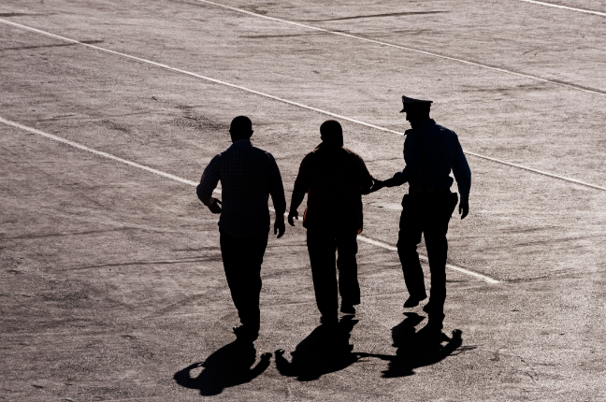
Scenario Update
At 9:30 am, the student puts the gun down and exits the classroom without further incident, and he is escorted from the building by the police. No one has been physically injured as a result of this incident.

Slide 23
Discussion
How does this event impact the rest of the school day? How will it impact the next several days?
What actions will you take to communicate with students, faculty, and staff? Do you consider an immediate debrief with faculty and staff?
What steps will you take in the coming days and weeks to address the trauma experienced by students, faculty, and staff?
Does this event impact how you will dismiss students for the day?
What, if any, communication would you make to parents prior to releasing students for the day? If you make a statement, who makes it, and how is it distributed?
Do you consider a quick de-brief with all staff to ensure they are okay prior to releasing them for the day? If so, who does it and how? If not, will you do one, and when?
Have you considered the Vermont School Safety Center resources in planning for an event like this?

Slide 24
Hotwash
Name a few identified strengths in your response to this incident.
Did you identify anything that’s not covered in your EOP?
Were any equipment needs identified?
What do you know now that you didn’t know prior to this exercise?
What action steps should this group take now? Are there changes or improvements that you will make?
What are the major lessons learned from today’s discussion?
What are the tentative next steps to continue the discussion and address any areas of concern?

Slide 25
Where do we go from here?
Specific Issues Identified | Person assigned to follow-up | Timeline of completion 3, 6, 9 months…

Slide 26
Stay Connected With Us
We would like to know if this exercise was helpful and hear about your experience with this training. Please reach out to us with your feedback to help us improve future training.
Rob Evans, Director of K-12 Services revans@cosecure.com.
Sunni Eriksen, Vermont School Safety Center Sunni.Eriksen@vermont.gov.
Dee Barbic, Director of Violence Prevention Dee.Barbic@vermont.gov.
Vermont School Safety Center https://schoolsafety.vermont.gov/
An affiliate of

