Slide 1
SOUTH BURLINGTON POLICE YOUTH SERVICES DIVISION

Slide 2
SBPD YOUTH SERVICES DIVISION
SCHOOL RESOURCE OFFICERS
SBPD has 3 officers assigned to the Youth Services Division.
Officers are responsible for coverage of 6 schools
-3 Elementary Schools
Chamberlin, Orchard, Central
-1 Middle School
FHTMS
-2 High Schools
SBHS, RICE

Slide 3
WHAT DOES A POLICE OFFICER DO IN A SCHOOL?

Slide 4
RESPONSIBILITIES OF A SCHOOL RESOURCE OFFICER (SRO)
SAFETY
LAW ENFORCEMENT
PREVENTION/TEACHER
COUNSELOR/MENTOR

Slide 5
SCHOOL RESOURCE OFFICERS (SRO)
SRO TRIAD CONCEPT
Law Enforcement Officer
Teacher
Counselor

Slide 6
SRO RESPONSIBILITIES-SAFETY
SRO’s are responsible for the safety and security of School students and staff should an emergency occur.
SROs are the point of communication between the school district and the Police Department.

Slide 7
SAFETY
SRO’s are part of each school’s Crisis Team, and continually work with each school on:
Emergency Planning
Crisis/Evacuation Drills
Safety Procedures

Slide 8
SRO RESPONSIBILITIES- LAW ENFORCEMENT
SRO deals with any crimes committed in school or in the community.
Typical issues include: Bullying, Truancy, Computer/ Cell Phone Crimes, Runaway juveniles, Thefts, Fights, Drug violations etc.
SRO’s work closely with school administration, guidance counselors, prevention counselors, and school based social workers to provide services to students, and their families.
SRO’s also assist Patrol Division in Juvenile cases which occur out in the Community with a youthful offender or victim

Slide 9
JUVENILE OFFENDER- CRIME COMMITTED Possible Consequences
The majority of cases handled by SRO’s are referred to the
South Burlington Community Justice Center
-First time offenders
-Willing to take responsibility
-Focuses on repairing the harm caused to the community or individuals
Other cases are referred to juvenile or adult court as necessary.

Slide 10
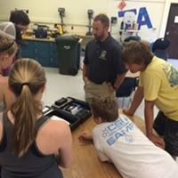
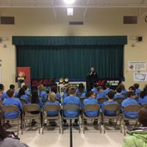
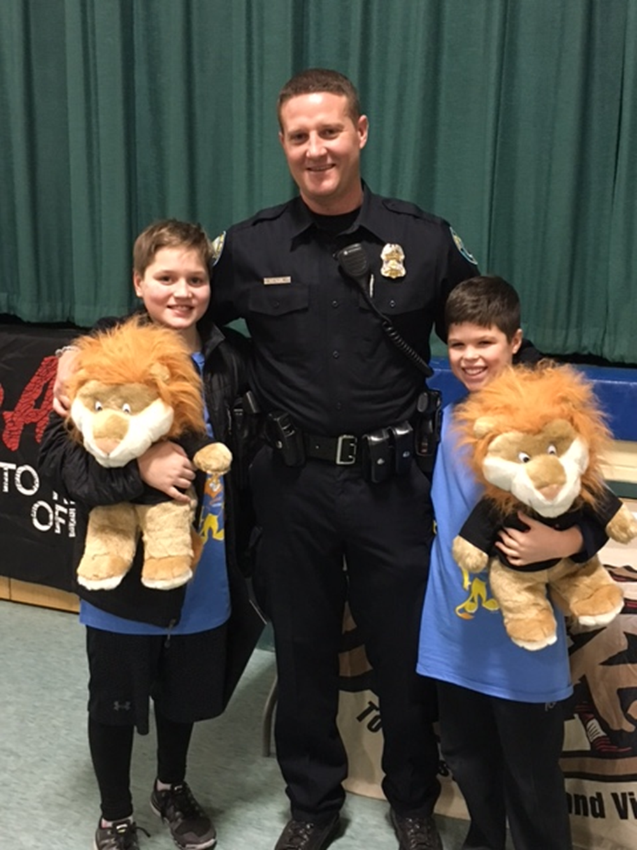
SRO RESPONSIBILITIES-TEACHING

Slide 11
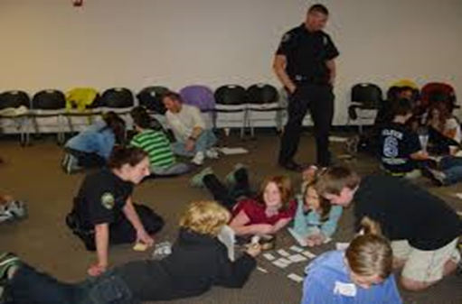
SRO RESPONSIBILITIES-TEACHING
D.A.R.E. Drug Prevention Program (5th and 7th grade)
Health Class Presentations
(Drug/Alcohol Unit, Sexting Presentation)
Driver’s Education Presentations
Bicycle Safety-Elementary Students
C.S.I. Summer Camp

Slide 12
DRUG ABUSE RESISTANCE EDUCATION
-10 Lesson Program instructed for all 5th and 7th Grade Students in the District by School Resource Officer
-Focus on Drug Prevention and Safe Decision Making

Slide 13
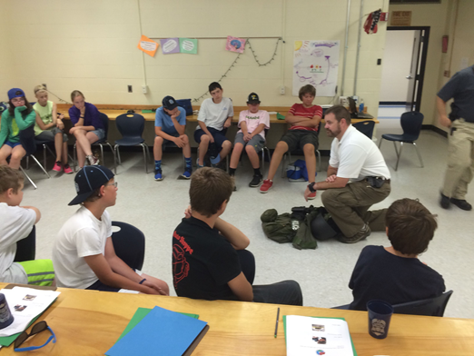
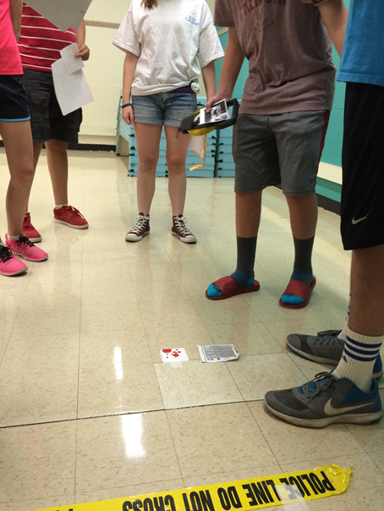
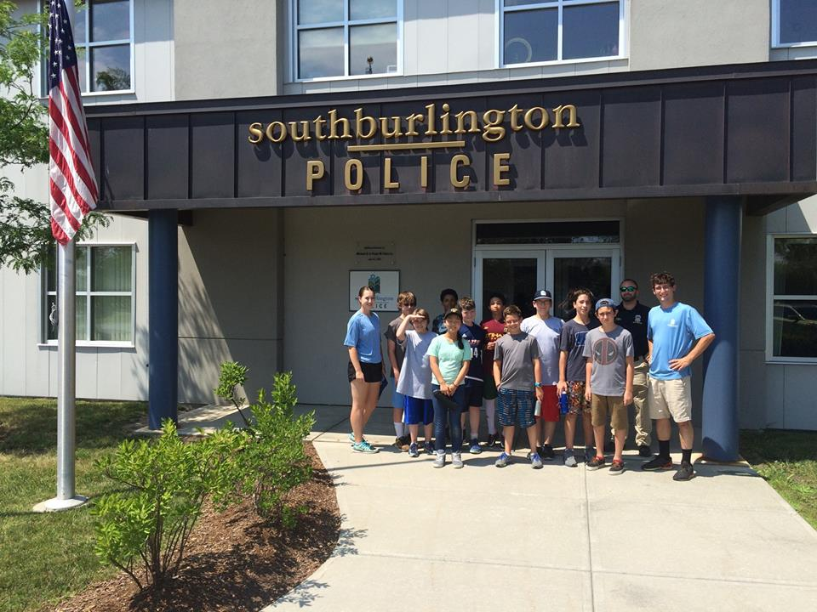
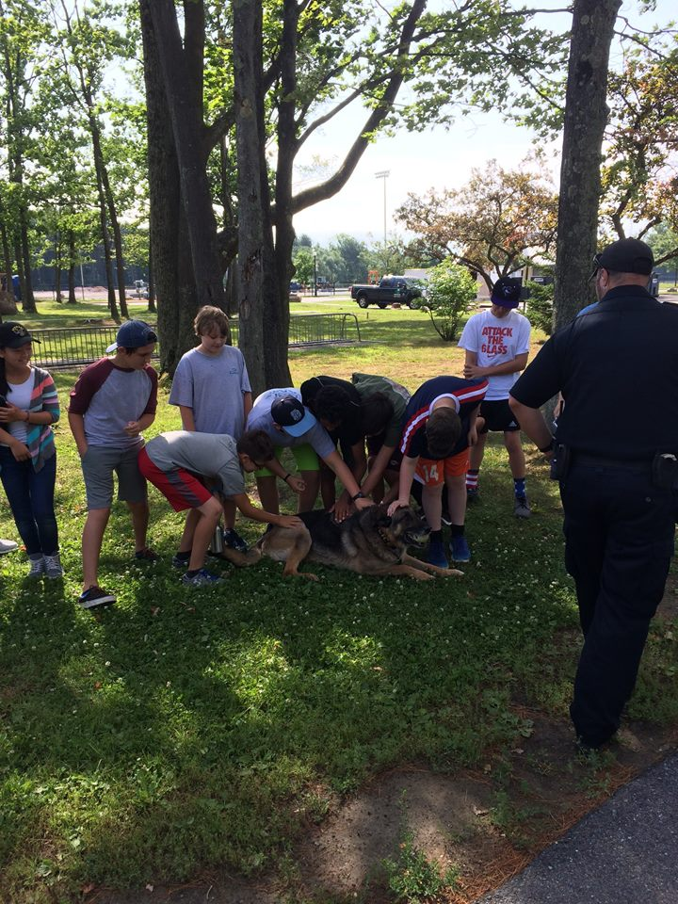
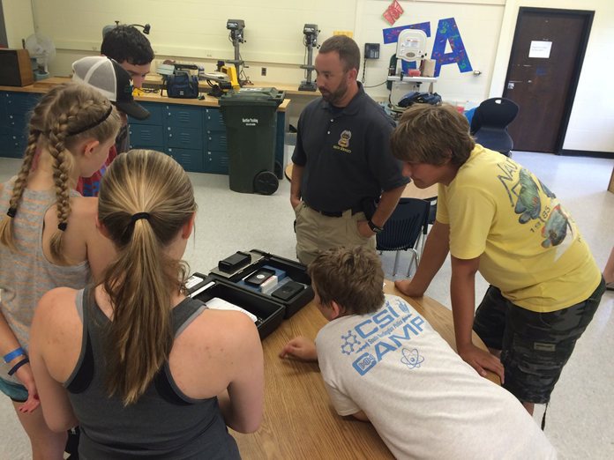

Slide 14
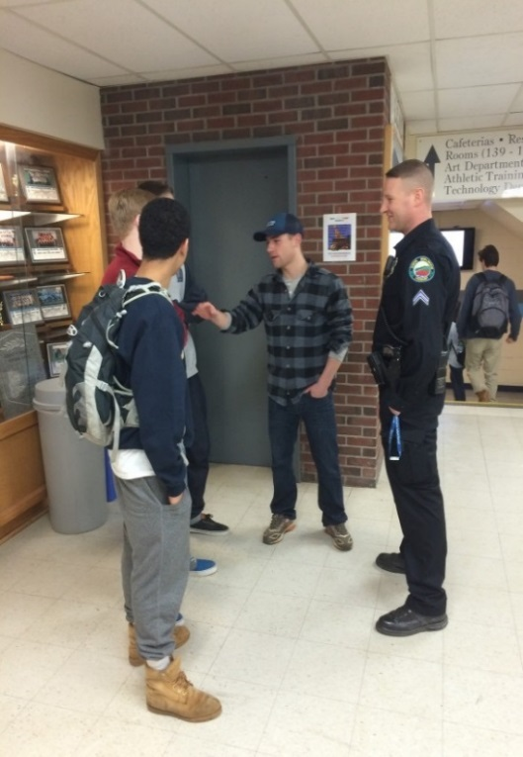
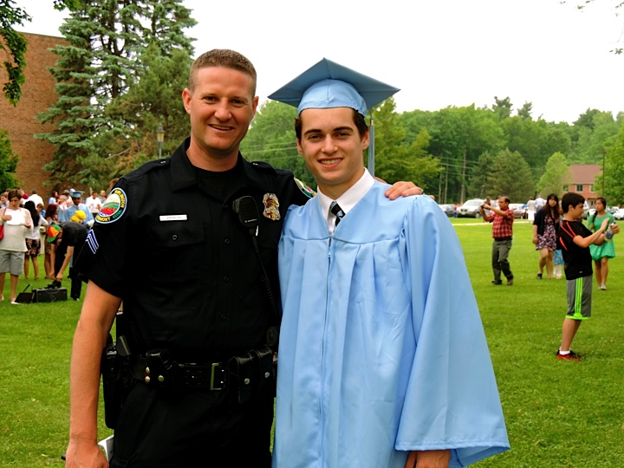
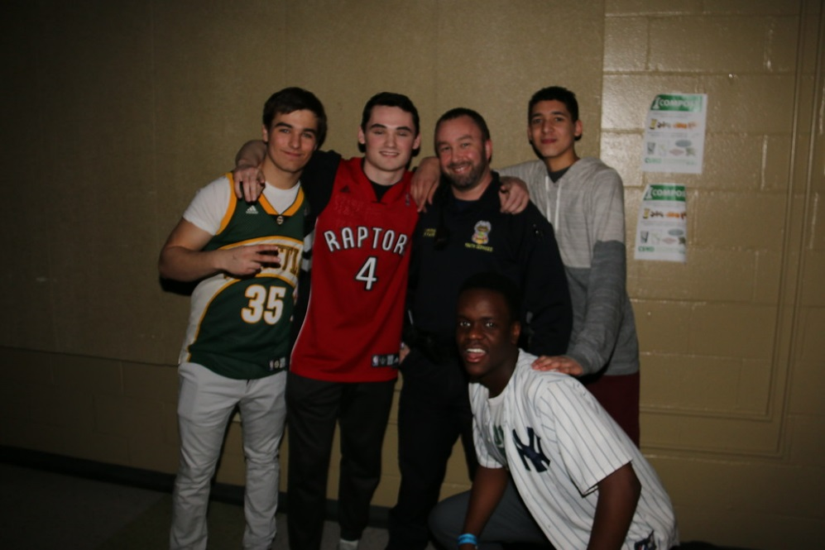
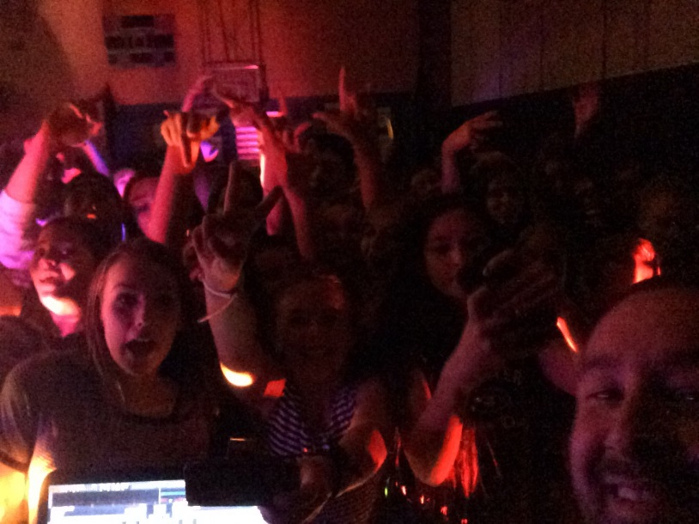
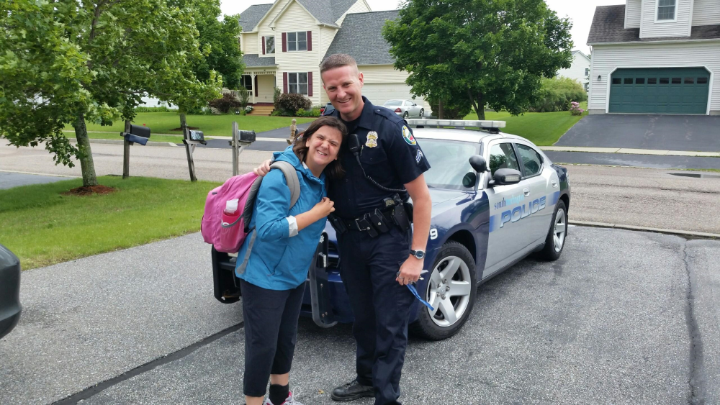
SRO RESPONSIBILITIES- COUNSELOR/MENTOR
SRO’s form healthy relationships with students by being apart of the school community. This results in students building trust with the SRO and the police. Once trust is built between the SRO and students, some students will rely on SRO for guidance, advice, and encouragement.
Parents of students in the community will also reach out to the SRO seeking guidance and advice on issues with their children.

Slide 15
Common SRO Selection Criteria
Minimum 2-3 years experience as patrol officer.
Strong desire to work with youth.
Ability to work independently.
Strong communication skills.
Desire to contribute in non-traditional role, (coaching/mentoring)

Slide 16
SRO Selection Process
Have members of the Police Department and members of the School District be a part of the interview/selection process.
Need buy in and input from district and pd to have an effective SRO program.

Slide 17
TRAINING AN SRO
NASRO- National Association of School Resource Officers, Basic and Advanced courses available.
D.A.R.E. Drug Abuse Resistance Education Instructor training
OJJDP -Office of Juvenile Justice for Delinquency Prevention
NCMEC- National Center for Missing and Exploited Children

Slide 18
COMMUNITY INTERACTION OPPORTUNITES AS AN SRO
Coaching Athletics
Recreation Department Events
Youth Groups
School/Community events

Slide 19
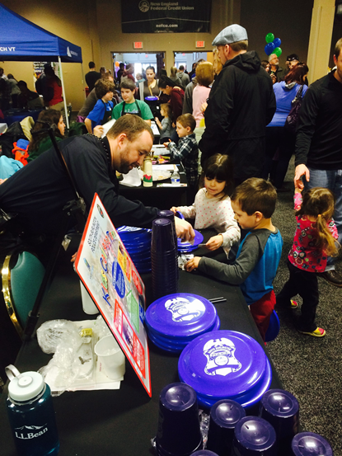
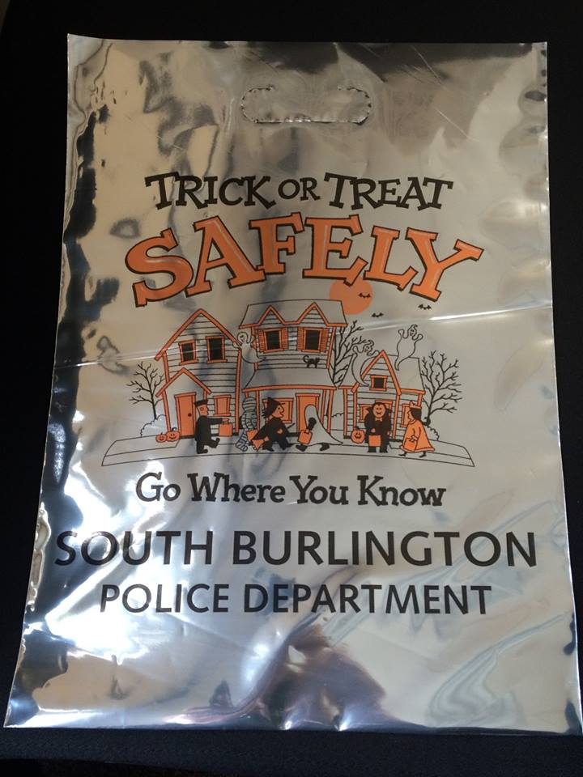
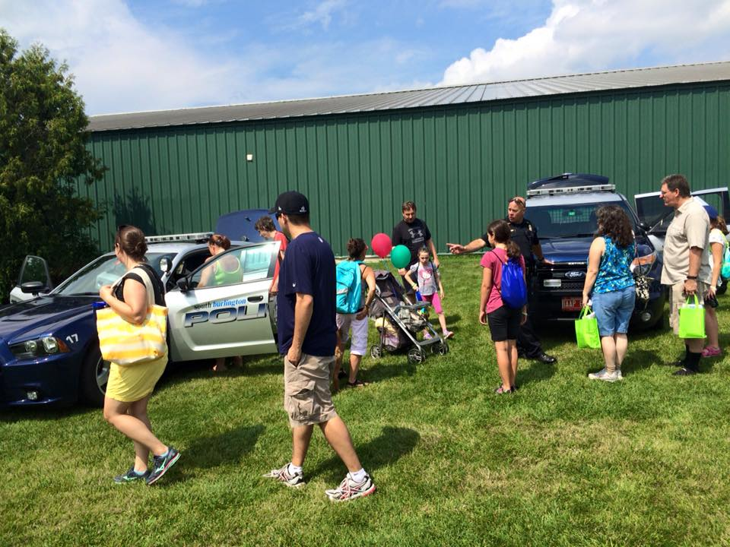
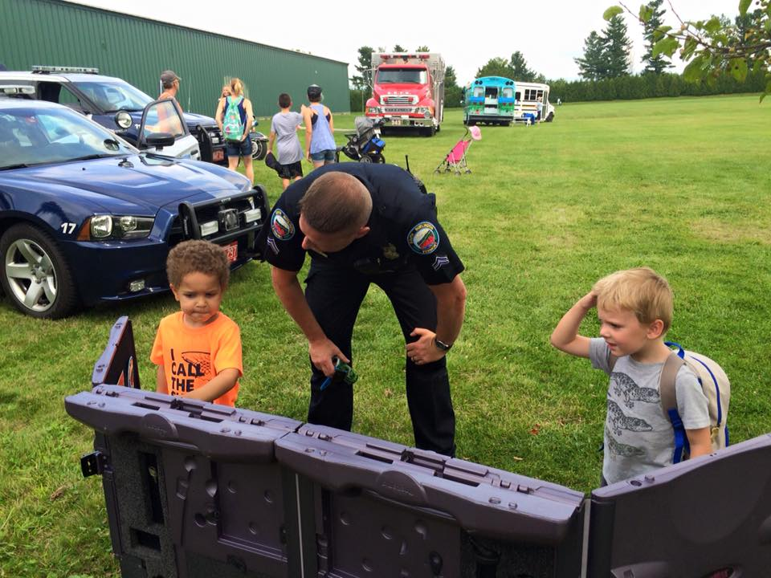
COMMUNITY EVENTS -Halloween Safety Day -Vermont Kids Day -South Burlington City Fest

Slide 20
Any Questions?

