Slide 1
Preventing Targeted School Violence

Slide 2
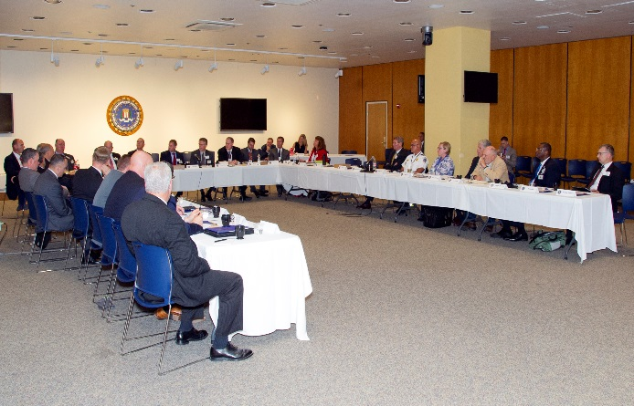
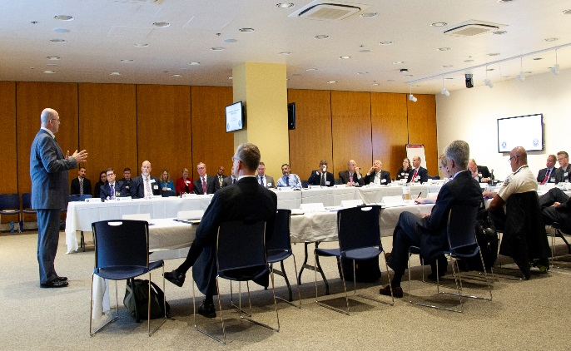
Introduction
(June, 2018) FBI School Safety Summit The FBI’s Office of Partner Engagement hosted a large group discussion with state and local law enforcement partners and federal executives at FBIHQ in which the following specific topics were identified as key and discussed:
Troubled students – Warning Signs and Behavioral Indicators
Crisis Intervention and Threat Assessments
Information Sharing – What’s Working, What’s Not
Role of SROs, School Crisis Response Plans, Law Enforcement Response Plans
Hardening of Schools.
OFFICE OF PARTNER ENGAGEMENT

Slide 3
The Scope of the Problem
Threat Environment
From 2000 to 2017, 52 active shooter incidents targeting schools.
High Schools – 48%; Institutions of Higher Ed – 29%
Roughly 25% of school attacks meet threshold for mass killing.
The FBI defines “mass killings” as murdering four or more persons during an event with no "cooling-off period" between the murders.
School attacks represent a nominal percentage of all yearly national homicides.
Schools and institutions of higher education have a lower risk of an attack.
OFFICE OF PARTNER ENGAGEMENT

Slide 4
Active Shooter Study
A Study of the Pre-Attack Behaviors of Active Shooters in the united States Between 2000 and 2013
Behavioral Analysis Unit (BAU)
June 2018
Available for download at: www.fbi.gov
Notes:
This BAU study is considered to be a follow up or “Phase II” to the original Active Shooter study published by the FBI in 2014. It was released on 20 June 2018 and is available for download at fbi.gov.
The BAU study looked at the pre-attack behaviors of 63 active shooters who attacked in the U.S. between the years 2000 and 2013. It is unique in that we relied almost exclusively upon law enforcement records (vs open source) in our three year exploration of these often very nuanced behaviors.
We encourage broad distribution of this study to law enforcement, mental health professionals, threat assessment teams, parents, teachers, students, and anyone who is a safety stakeholder within a community.

Slide 5
Active Shooter Study
The BAU has also produced a Quick Reference Guide which summarizes the results of the study and is widely available for distribution on: www.fbi.gov
Notes:
This BAU study is considered to be a follow up or “Phase II” to the original Active Shooter study published by the FBI in 2014. It was released on 20 June 2018 and is available for download at fbi.gov.
The BAU study looked at the pre-attack behaviors of 63 active shooters who attacked in the U.S. between the years 2000 and 2013. It is unique in that we relied almost exclusively upon law enforcement records (vs open source) in our three year exploration of these often very nuanced behaviors.
We encourage broad distribution of this study to law enforcement, mental health professionals, threat assessment teams, parents, teachers, students, and anyone who is a safety stakeholder within a community.

Slide 6
Key Findings: Planning
In the cases where it could be determined, active shooters take time to plan and prepare for the attack:
77% of the subjects spent a week or longer planning their attack
46% spent a week or longer actually preparing (procuring the means) for the attack.
Notes:
This BAU study is considered to be a follow up or “Phase II” to the original Active Shooter study published by the FBI in 2014. It was released on 20 June 2018 and is available for download at fbi.gov.
The BAU study looked at the pre-attack behaviors of 63 active shooters who attacked in the U.S. between the years 2000 and 2013. It is unique in that we relied almost exclusively upon law enforcement records (vs open source) in our three year exploration of these often very nuanced behaviors.
We encourage broad distribution of this study to law enforcement, mental health professionals, threat assessment teams, parents, teachers, students, and anyone who is a safety stakeholder within a community.

Slide 7
Key Findings: Planning
Notes:
This BAU study is considered to be a follow up or “Phase II” to the original Active Shooter study published by the FBI in 2014. It was released on 20 June 2018 and is available for download at fbi.gov.
The BAU study looked at the pre-attack behaviors of 63 active shooters who attacked in the U.S. between the years 2000 and 2013. It is unique in that we relied almost exclusively upon law enforcement records (vs open source) in our three year exploration of these often very nuanced behaviors.
We encourage broad distribution of this study to law enforcement, mental health professionals, threat assessment teams, parents, teachers, students, and anyone who is a safety stakeholder within a community.

Slide 8
Key Findings: Attack Preparation
Notes:
This BAU study is considered to be a follow up or “Phase II” to the original Active Shooter study published by the FBI in 2014. It was released on 20 June 2018 and is available for download at fbi.gov.
The BAU study looked at the pre-attack behaviors of 63 active shooters who attacked in the U.S. between the years 2000 and 2013. It is unique in that we relied almost exclusively upon law enforcement records (vs open source) in our three year exploration of these often very nuanced behaviors.
We encourage broad distribution of this study to law enforcement, mental health professionals, threat assessment teams, parents, teachers, students, and anyone who is a safety stakeholder within a community.

Slide 9
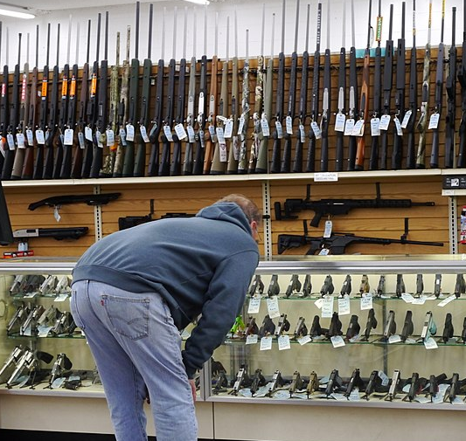
Key Findings: Accessing Firearms
A majority of active shooters obtained their firearms legally, with only very small percentages obtaining a firearm illegally.
Notes:
This BAU study is considered to be a follow up or “Phase II” to the original Active Shooter study published by the FBI in 2014. It was released on 20 June 2018 and is available for download at fbi.gov.
The BAU study looked at the pre-attack behaviors of 63 active shooters who attacked in the U.S. between the years 2000 and 2013. It is unique in that we relied almost exclusively upon law enforcement records (vs open source) in our three year exploration of these often very nuanced behaviors.
We encourage broad distribution of this study to law enforcement, mental health professionals, threat assessment teams, parents, teachers, students, and anyone who is a safety stakeholder within a community.

Slide 10
Key Findings: Accessing Firearms
Notes:
This BAU study is considered to be a follow up or “Phase II” to the original Active Shooter study published by the FBI in 2014. It was released on 20 June 2018 and is available for download at fbi.gov.
The BAU study looked at the pre-attack behaviors of 63 active shooters who attacked in the U.S. between the years 2000 and 2013. It is unique in that we relied almost exclusively upon law enforcement records (vs open source) in our three year exploration of these often very nuanced behaviors.
We encourage broad distribution of this study to law enforcement, mental health professionals, threat assessment teams, parents, teachers, students, and anyone who is a safety stakeholder within a community.

Slide 11
Key Findings: Mental Health
The FBI could only verify that 25% of active shooters in the study had ever been diagnosed with a mental illness.
Of those diagnosed, only 3 had been diagnosed with a psychotic disorder.
Notes:
This BAU study is considered to be a follow up or “Phase II” to the original Active Shooter study published by the FBI in 2014. It was released on 20 June 2018 and is available for download at fbi.gov.
The BAU study looked at the pre-attack behaviors of 63 active shooters who attacked in the U.S. between the years 2000 and 2013. It is unique in that we relied almost exclusively upon law enforcement records (vs open source) in our three year exploration of these often very nuanced behaviors.
We encourage broad distribution of this study to law enforcement, mental health professionals, threat assessment teams, parents, teachers, students, and anyone who is a safety stakeholder within a community.

Slide 12
Key Findings: Stressors
Overall, the data reflects that active shooters were typically experiencing multiple stressors (an average of 3.6 separate stressors) in the year before they attacked.
Notes:
This BAU study is considered to be a follow up or “Phase II” to the original Active Shooter study published by the FBI in 2014. It was released on 20 June 2018 and is available for download at fbi.gov.
The BAU study looked at the pre-attack behaviors of 63 active shooters who attacked in the U.S. between the years 2000 and 2013. It is unique in that we relied almost exclusively upon law enforcement records (vs open source) in our three year exploration of these often very nuanced behaviors.
We encourage broad distribution of this study to law enforcement, mental health professionals, threat assessment teams, parents, teachers, students, and anyone who is a safety stakeholder within a community.

Slide 13
Key Findings: Stressors
Notes:
This BAU study is considered to be a follow up or “Phase II” to the original Active Shooter study published by the FBI in 2014. It was released on 20 June 2018 and is available for download at fbi.gov.
The BAU study looked at the pre-attack behaviors of 63 active shooters who attacked in the U.S. between the years 2000 and 2013. It is unique in that we relied almost exclusively upon law enforcement records (vs open source) in our three year exploration of these often very nuanced behaviors.
We encourage broad distribution of this study to law enforcement, mental health professionals, threat assessment teams, parents, teachers, students, and anyone who is a safety stakeholder within a community.

Slide 14
Key Findings: Concerning Behaviors
On average, each active shooter displayed between four and five concerning behaviors over time that were observable to others around the shooter. The most frequently occurring concerning behaviors were related to the active shooter’s mental health, problematic interpersonal interactions, and leakage of violent intent.
Notes:
This BAU study is considered to be a follow up or “Phase II” to the original Active Shooter study published by the FBI in 2014. It was released on 20 June 2018 and is available for download at fbi.gov.
The BAU study looked at the pre-attack behaviors of 63 active shooters who attacked in the U.S. between the years 2000 and 2013. It is unique in that we relied almost exclusively upon law enforcement records (vs open source) in our three year exploration of these often very nuanced behaviors.
We encourage broad distribution of this study to law enforcement, mental health professionals, threat assessment teams, parents, teachers, students, and anyone who is a safety stakeholder within a community.

Slide 15
Key Findings: Concerning Behaviors
Notes:
This BAU study is considered to be a follow up or “Phase II” to the original Active Shooter study published by the FBI in 2014. It was released on 20 June 2018 and is available for download at fbi.gov.
The BAU study looked at the pre-attack behaviors of 63 active shooters who attacked in the U.S. between the years 2000 and 2013. It is unique in that we relied almost exclusively upon law enforcement records (vs open source) in our three year exploration of these often very nuanced behaviors.
We encourage broad distribution of this study to law enforcement, mental health professionals, threat assessment teams, parents, teachers, students, and anyone who is a safety stakeholder within a community.

Slide 16
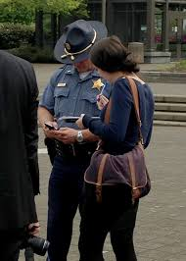
Key Findings: Concerning Behaviors
When concerning behavior was observed by others, the most common response was to communicate directly to the active shooter (83%) or do nothing (54%). In 41% of the cases the concerning behavior was reported to law enforcement. Therefore, just because concerning behavior was recognized does not necessarily mean that it was reported to law enforcement.
Notes:
This BAU study is considered to be a follow up or “Phase II” to the original Active Shooter study published by the FBI in 2014. It was released on 20 June 2018 and is available for download at fbi.gov.
The BAU study looked at the pre-attack behaviors of 63 active shooters who attacked in the U.S. between the years 2000 and 2013. It is unique in that we relied almost exclusively upon law enforcement records (vs open source) in our three year exploration of these often very nuanced behaviors.
We encourage broad distribution of this study to law enforcement, mental health professionals, threat assessment teams, parents, teachers, students, and anyone who is a safety stakeholder within a community.

Slide 17
Key Findings: Primary Grievances
In those cases where the active shooter’s primary grievance could be identified, the most common grievances were related to an adverse interpersonal or employment action against the shooter.
Notes:
This BAU study is considered to be a follow up or “Phase II” to the original Active Shooter study published by the FBI in 2014. It was released on 20 June 2018 and is available for download at fbi.gov.
The BAU study looked at the pre-attack behaviors of 63 active shooters who attacked in the U.S. between the years 2000 and 2013. It is unique in that we relied almost exclusively upon law enforcement records (vs open source) in our three year exploration of these often very nuanced behaviors.
We encourage broad distribution of this study to law enforcement, mental health professionals, threat assessment teams, parents, teachers, students, and anyone who is a safety stakeholder within a community.

Slide 18
Key Findings: Primary Grievances
Notes:
This BAU study is considered to be a follow up or “Phase II” to the original Active Shooter study published by the FBI in 2014. It was released on 20 June 2018 and is available for download at fbi.gov.
The BAU study looked at the pre-attack behaviors of 63 active shooters who attacked in the U.S. between the years 2000 and 2013. It is unique in that we relied almost exclusively upon law enforcement records (vs open source) in our three year exploration of these often very nuanced behaviors.
We encourage broad distribution of this study to law enforcement, mental health professionals, threat assessment teams, parents, teachers, students, and anyone who is a safety stakeholder within a community.

Slide 19
School Attacks
Myth: Random/impulsive act of violence
Reality: Perpetrators don’t snap
They often plan their attacks weeks and months in advance.
Frequency of school attacks results in a contagion effect
Generally within 2 weeks of publicized school shooting
Shooters research past attacks, tactics, perpetrators
Spawns copycat attacks
Other people had information of impending attack that could have prevented violence
OFFICE OF PARTNER ENGAGEMENT

Slide 20
School Shooters Motivators
The “Columbine effect” continues to inspire youth to conduct targeted attacks:
View Columbine H.S. as a mecca for shooters
Credited with inspiring roughly 80 copycat attacks
Created a cultural script for would-be shooters
Shooters are “injustice collectors”
Resentment over perceived slights or wrongs
Seek notoriety or fame
Seek revenge, retaliation, or develop a sense of mission or destiny
OFFICE OF PARTNER ENGAGEMENT

Slide 21
Emerging Motivators
Risk factors include victimization, teacher injury, bullying, cyber-bullying, fights, weapons, gangs, drugs, and alcohol abuse
Involuntary Celibacy (INCEL)
Frustration with lack of social status, intimate relationships, or heightened sense of entitlement
Manifests into misogynistic views against women or sexually active men
OFFICE OF PARTNER ENGAGEMENT

Slide 22
Warning Behaviors
Most school shooters do not communicate a direct threat to an intended target
Shooters broadcast their violent intentions in weeks leading up to attack
Legacy tokens
Messages crafted by attackers to claim responsibility for their actions and outline the underlying motivations
Include manifestos, videos, or social media postings
Manifestos are crafted by nearly one-third of all active shooters
OFFICE OF PARTNER ENGAGEMENT

Slide 23
Roles of Bystanders
Bystander may be a family member, peer, authority figure, educator or stranger
A 2008 US Secret Service study on school attacks concluded:
93% of attackers exhibited concerning behaviors prior to an attack
81% of attacks were known by other individuals
93% of other individuals were peers
Although not predictable, acts of targeted school violence are often preventable
Early identification is key to prevention
OFFICE OF PARTNER ENGAGEMENT

Slide 24
Building Awareness
Enhanced Family Involvement
Identifying/communicating concerning behaviors
Establish Anonymous Tip Lines
Safe Oregon/Safe2Tell Colorado
Enhanced active shooter training for kids, educators (teach how to survive an attack)
Knock and Talk Programs
OFFICE OF PARTNER ENGAGEMENT

Slide 25
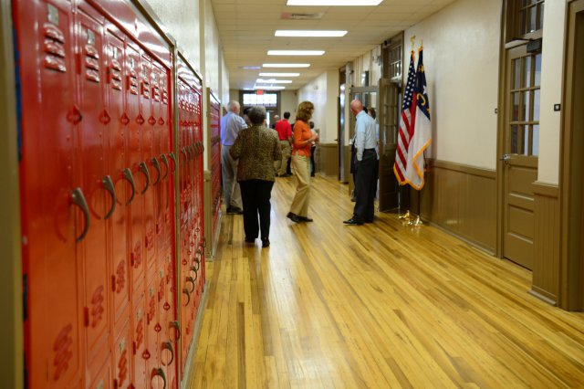
Examples of School Hardening
BASIC School Hardening
Locking all external facing doors during class hours
Having a School Resource Officer (SRO) on school grounds
Bi-annual active shooter drills performed by staff and students
Installing security cameras at school entrance points
OFFICE OF PARTNER ENGAGEMENT

Slide 26
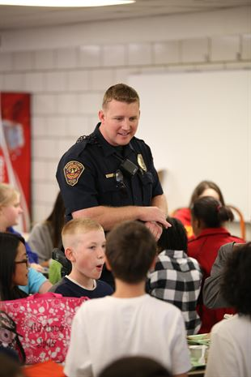
Examples of School Hardening
MODERATE School Hardening
Limiting access points to 1 or 2 doorways
Securing/locking all external facing doors during school hours
CCTV/video cameras at external access points
Multiple SROs on campus and tending access points
Quarterly active shooter drills for teachers and students
Communication plan in place with local PD/Sherriff’s Office
OFFICE OF PARTNER ENGAGEMENT

Slide 27
Examples of School Hardening
ADVANCED School Hardening
Limiting access points to 1 entrance/exit with metal detectors
Securing/locking all external facing doors during school hours
CCTV/video cameras in hallways and access points with direct feeds to local PD or Sherriff’s Office.
Police and SRO armed presence in hallways and access points
Monthly active shooter drills for teachers and students
Communication devices in classrooms
Armed teachers and/or school administrators
Smoke devices installed in hallways
Bullet proof/resistant doors for all classrooms
OFFICE OF PARTNER ENGAGEMENT

Slide 28
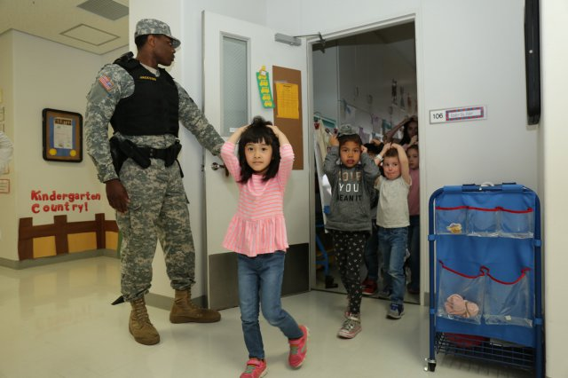
Different Perspective on School Shooter Training
A November 1, 2018 article headline from the Washington Post:
“Mom: Thanks to active-shooter drills at school, my 4 –year-old thought fireworks were gunshots. Enough already.”
OFFICE OF PARTNER ENGAGEMENT

Slide 29
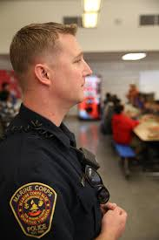
Prevention
A national poll of SROs concluded that 20% of schools are not prepared for an active shooter incident
Best protective strategy is PREVENTION
Assess school climate regularly
Promote Inclusiveness and empowerment
Eliminate punitive discipline practices (zero tolerance)
Creates racial disparities, false positives, or resentment
OFFICE OF PARTNER ENGAGEMENT

Slide 30
Prevention Success Stories
Lawrenceburg, KY (October, 2018) A mother called local police to report a man harassing her. Police were dispatched to the individual’s home where hey intercepted him backing out of his driveway with weapons, ammunition, and detailed plans to attack a local school.
Rockville, MD (October, 2018) A student reported another student to the Montgomery Police posted who had posted social media threats and photos of him with and AR-15 and the words “school shooter.” Officers arrested the student before any attack.
Mars, PA (October, 2018) Students reported multiple bomb threats written on papers and walls throughout the school and administrators evacuated the school as a result.
OFFICE OF PARTNER ENGAGEMENT

Slide 31
Prevention Success Stories
Chesterfield County, SC (October, 2018) Two separate incidents in which student made verbal or social media threats while on school campuses were immediately reported by other students that had seen and/or overhead the threats to shoot up the schools.
Bartow, FL (October 2018): A mother called in after receiving an automated call from the school reporting that her daughter was not in second period class. The girl, and another girl were found in the bathroom plotting to stab other students and drink their blood. After which they planned to kill themselves.
OFFICE OF PARTNER ENGAGEMENT

Slide 32
Prevention
Prevention: Establish a three-tiered community prevention model
Pre-event; Threat Assessment Standardized Protocol; Monitoring
Pre-event: Tip lines and other reporting mechanisms
Threat Assessments: Establish multi-disciplinary threat assessment teams
CIT
Virginia Student Threat Assessment Guidelines
Salem Keizer Threat Assessment Model
Monitor: Continue to observe escalating behaviors and implement countermeasures
OFFICE OF PARTNER ENGAGEMENT

Slide 33
Collaboration and Training
Documentary: Echoes of Columbine
(November, 2018) FBI releases school violence film: Echoes of Columbine, a film designed to assist school administrators and SROs about threat assessments and other preventative practices specific to school attacks.
30 minutes
Dissemination in December, 2018
OFFICE OF PARTNER ENGAGEMENT

Slide 34
Questions?
Kerry Sleeper
Assistant Director
OFFICE OF PARTNER ENGAGEMENT
FEDERAL BUREAU OF INVESTIGATION
OFFICE OF PARTNER ENGAGEMENT

Slide 36
Crisis Intervention & Threat Assessments
Step 1: Establish a multidisciplinary threat assessment team of school personnel including faculty, staff, administrators, coaches, and available school resource officers who will direct, manage, and document the threat assessment process.
Step 2: Define behaviors, including those that are prohibited and should trigger immediate intervention (e.g., threats, violent acts, and weapons on campus) and other concerning behaviors that require a threat assessment.
Step 3: Establish and provide training on a central reporting system such as an online form on the school website, email address, phone number, smartphone application, or other mechanisms. Ensure that it provides anonymity to those reporting concerns and is monitored by personnel who will follow-up on all reports.
Step 4: Determine the threshold for law enforcement intervention, especially if there is a safety risk.
OFFICE OF PARTNER ENGAGEMENT

Slide 37
Information Sharing
Tip Lines:
Safe2Tell Colorado gives YOU a safe, anonymous way to help someone who is struggling or hurting. Learn what to look for, what to listen for, and what to report. www.Safe2tell.org
Texas Suspicious Activity Reporting Network iWatchTexas website where you can report suspicious activities or behaviors that may indicate criminal, terroristic, or school safety-related threats. www.iwatchtx.org
The public can report violations of U.S. federal law or suspected terrorism or criminal activity to the FBI online or via telephone or mail. www.fbi.gov/tips
Multi-disciplinary teams:
The exchange of information and resources derived from mulit-disciplinery teams and multiple agencies develops partnerships and is fundamental to providing a coordinated response to terrorism and criminal-related issues.
OFFICE OF PARTNER ENGAGEMENT

Slide 38
Law Enforcement Roles
SROs: An SRO is a career law enforcement officer with sworn authority who is deployed by an employing police department or agency in a community-oriented policing assignment to work with one or more schools. An SRO’s three main roles are educator (i.e. guest lecturer), informal counselor/mentor, and law enforcement officer.
LE Response Plans: Local LE officers will constitute a primary (solo response, contact teams, off-duty officers), and secondary teams (rescue teams, EMS, warm zones, perimeter security, evacuation and assistance teams)
Active Shooter exercises: LE officers will facilitate and participate in elements such as workshops, seminars, TTXs, games, operations-based exercises, drills, functional exercises (FEs), and full-scale execrises (FSEs).
OFFICE OF PARTNER ENGAGEMENT

